Slide 1
Algorithm Analysis
Courtesy: Md. Manowarul Islam, Asst. Prof., Dept. of CSE, JnU.

Slide 2
Introduction
Data structures
  Methods of organizing data in order to facilitate access and modification.
What is Algorithm?
  a clearly specified set of simple instructions on the data to be followed to solve a problem
    Takes a set of values, as input and
    produces a value, or set of values, as output
  May be specified
    In English
    As a computer program
    As a pseudo-code
Program = data structures + algorithms

Slide 3
Introduction
Why need algorithm analysis ?
  writing a working program is not good enough
  The program may be inefficient!
  If the program is run on a large data set, then the running time becomes an issue

Slide 4
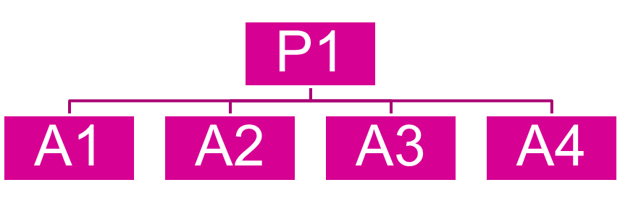
Introduction
Suppose we have a problem P1 to solve
We have many algorithms.
Which one of the above algorithms will choose?
Analyzing an algorithm
  Predicting the resources that the algorithm requires
  Resources include
    Memory
    Computational time (usually most important)

Slide 5
Example: Selection Problem
Given a list of N numbers, determine the kth largest, where k ≤ N.
Algorithm 1:
  (1) Read N numbers into an array
  (2) Sort the array in decreasing order by some simple algorithm
  (3) Return the element in position k

Slide 6
Algorithm 2:
  (1) Read the first k elements into an array and sort them in decreasing order
  (2) Each remaining element is read one by one
    If smaller than the kth element, then it is ignored
    Otherwise, it is placed in its correct spot in the array, bumping one element out of the array.
  (3) The element in the kth position is returned as the answer.

Slide 7
Which algorithm is better when
  N =100 and k = 100?
  N =100 and k = 1?
What happens when
  N = 1,000,000 and k = 500,000?
We come back after sorting analysis, and there exist better algorithms

Slide 8
Algorithm Analysis
We only analyze correct algorithms
An algorithm is correct
  If, for every input instance, it halts with the correct output
Incorrect algorithms
  Might not halt at all on some input instances
  Might halt with other than the desired answer
Analyzing an algorithm
  Predicting the resources that the algorithm requires
  Resources include
    Memory
    Computational time (usually most important)

Slide 9
Factors affecting the running time
  computer
  compiler
  algorithm used
  input to the algorithm
    The content of the input affects the running time
    typically, the input size (number of items in the input) is the main consideration
      E.g. sorting problem ⇒ the number of items to be sorted
      E.g. multiply two matrices together ⇒ the total number of elements in the two matrices
Machine model assumed
  Instructions are executed one after another, with no concurrent operations ⇒ Not parallel computers

Slide 10
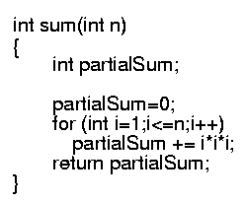
Example
Calculate
Lines 1 and 4 count for one unit each
Line 3: executed N times, each time four units
Line 2: (1 for initialization, N+1 for all the tests, N for all the increments) total 2N + 2
total cost: 6N + 4 ⇒ O(N)
1
2
3
4
1
2N+2
4N
1

Slide 11
Time Complexity
For most of the algorithms associated with this course, time complexity comparisons are more interesting than space complexity comparisons
Time complexity: A measure of the amount of time required to execute an algorithm
13-<number>

Slide 12
Time Complexity
Factors that should not affect time complexity analysis:
  The programming language chosen to implement the algorithm
  The quality of the compiler
  The speed of the computer on which the algorithm is to be executed
13-<number>

Slide 13
Time Complexity
Analysis is based on the amount of work done by the algorithm
Time complexity expresses the relationship between the size of the input and the run time for the algorithm
Usually expressed as a proportionality, rather than an exact function
13-<number>

Slide 14

Why should we care????

Slide 15
Let see….
Suppose Rahim and Karim are two students and they both have given a same assigmnet.
  Determine whether a number n is prime or not.
  Example of prime numbers: 2,3,5,7

Slide 16
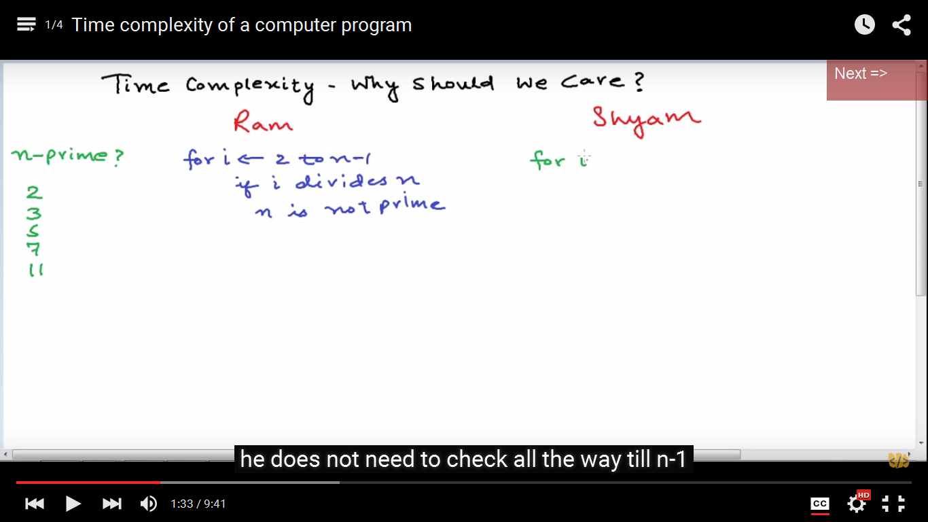
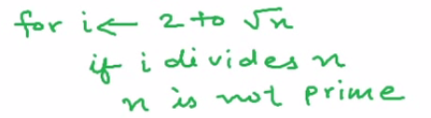
Let see….
Rahim
Karim
N-1 divisions
√N-1 divisions
Both the algorithms will give the right answer
But for a large value of n , Rahim’s program
will run for several days!!!!!!!!

Slide 17
Let see….
Rahim
Karim
N-1 divisions
√N-1 divisions
Lets assume, the computer takes 1 ms for a division

Slide 18
Let see….
Rahim
Karim
n-1 divisions
√n-1 divisions
Lets assume, the computer takes 1 ms for a division
input | Algorithm-1 | Algorithm-2
n=11(pirme numbers) | 9 ms | 2 ms

Slide 19
Let see….
Rahim
Karim
n-1 divisions
√n-1 divisions
Lets assume, the computer takes 1 ms for a division
input | Algorithm-1 | Algorithm-2
n=11(pirme numbers) | 9 ms | 2 ms
n=101 | 99ms | 9 ms

Slide 20
Let see….
Rahim
Karim
n-1 divisions
√n-1 divisions
Lets assume, the computer takes 1 ms for a division
input | Algorithm-1 | Algorithm-2
n=11(pirme numbers) | 9 ms | 2 ms
n=101 | 99ms | 9 ms
n=1000003=10⁶+3 | 10⁶ ms =10³sec 16.6 mins | √(10⁶+3)-1 ≈10³ms ≈1 sec

Slide 21
Let see….
Rahim
Karim
n-1 divisions
√n-1 divisions
input | Algorithm-1 | Algorithm-2
n=11(pirme numbers) | 9 ms | 2 ms
n=101 | 99ms | 9 ms
n=1000003=10⁶+3 | 10⁶ ms =10³sec 16.6 mins | √(10⁶+3)-1 ≈10³ms ≈1 sec
n=10000000019 | 10¹⁰ms=10⁷ sec ≈115 days | ≈10⁵ms=100sec ≈1.66 mins

Slide 22
Let see….
Rahim
Karim
n-1 divisions
√n-1 divisions
input | Algorithm-1 | Algorithm-1
n=11(pirme numbers) | 9 ms | 2 ms
n=101 | 99ms | 9 ms
n=1000003=10⁶+3 | 10⁶ ms =10³sec 16.6 mins | √(10⁶+3)-1 ≈10³ms ≈1 sec
n=10000000019 | 10¹⁰ms=10⁷ sec ≈115 days | ≈10⁵ms=100sec ≈1.66 mins

Slide 23
Typical Running Time Functions
1 (constant running time):
  Instructions are executed once or a few times
logN (logarithmic)
  A big problem is solved by cutting the original problem in smaller sizes, by a constant fraction at each step
N (linear)
  A small amount of processing is done on each input element
N logN
  A problem is solved by dividing it into smaller problems, solving them independently and combining the solution

Slide 24
Typical Running Time Functions
N² (quadratic)
  Typical for algorithms that process all pairs of data items (double nested loops)
N³ (cubic)
  Processing of triples of data (triple nested loops)
N^{K} (polynomial)
2^{N} (exponential)
  Few exponential algorithms are appropriate for practical use

Slide 25
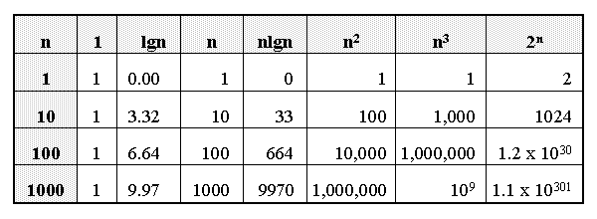
Growth of Functions

Slide 26
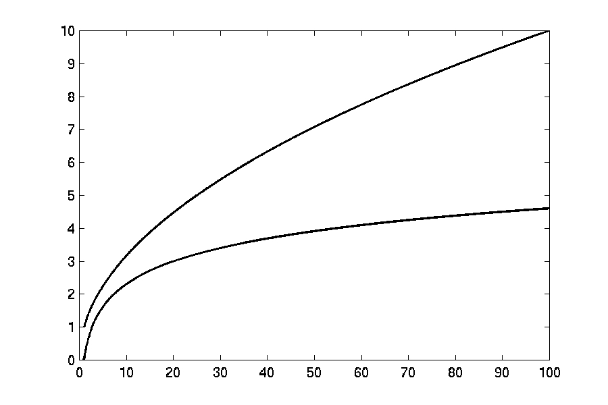

Complexity Graphs
log(n)

Slide 27
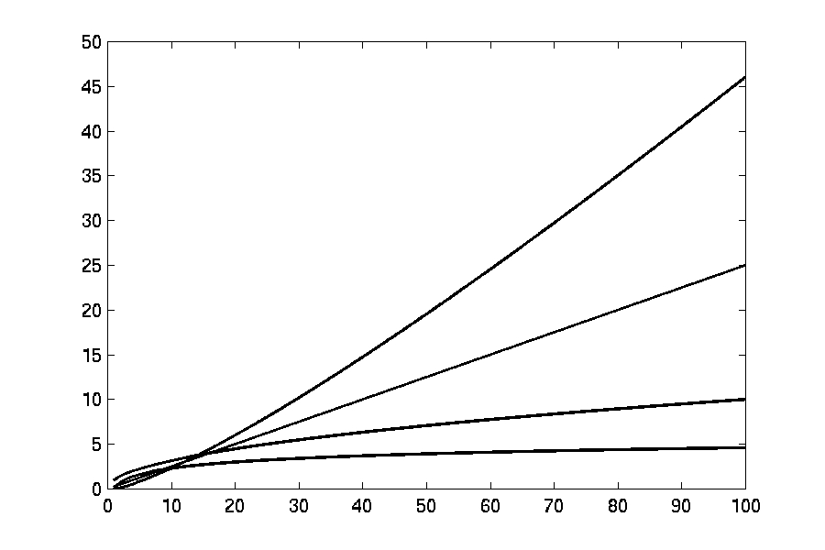
Complexity Graphs
n log(n)
n
log(n)

Slide 28
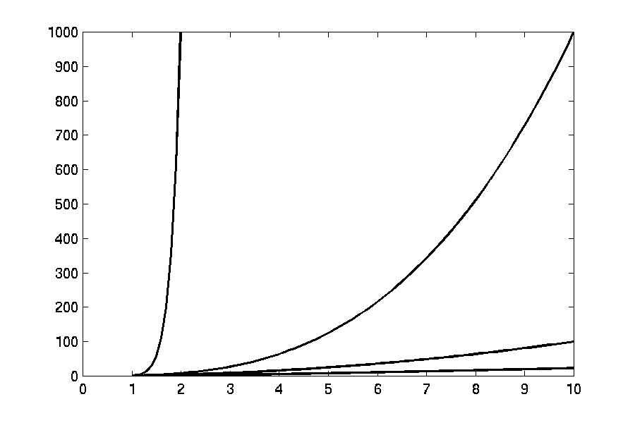
Complexity Graphs
n¹⁰
n³
n²
n log(n)

Slide 29
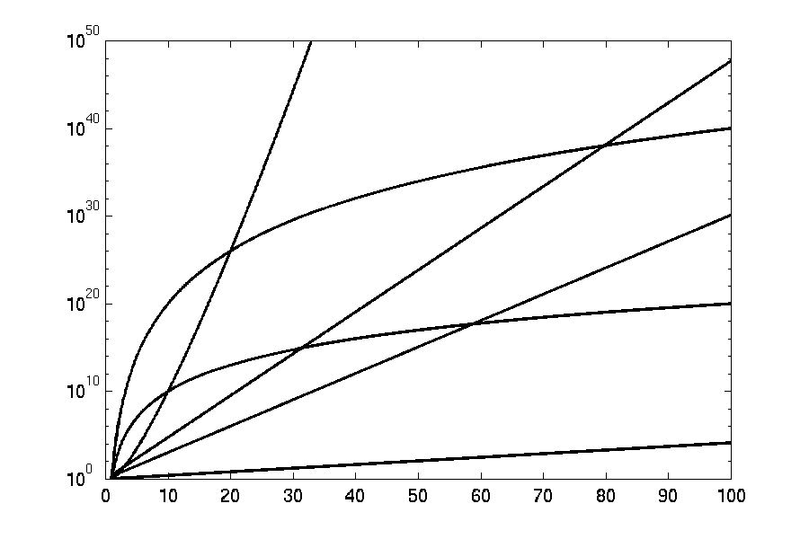
Complexity Graphs (log scale)
3^{n}
n^{n}
n²⁰
2^{n}
n¹⁰
1.1^{n}

Slide 30
Running-time of algorithms
Bounds are for the algorithms, rather than programs
  programs are just implementations of an algorithm, and almost always the details of the program do not affect the bounds
Algorithms are often written in pseudo-codes
  We use ‘almost’ something like C/C++.
Bounds are for algorithms, rather than problems
  A problem can be solved with several algorithms, some are more efficient than others

Slide 31
Introduction
Why are asymptotic notations important?
They give a simple characterization of an algorithm’s efficiency.
They allow the comparison of the performances of various algorithms.
For large values of components/inputs, the multiplicative constants and lower order terms of an exact running time are dominated by the effects of the input size (the number of components).

Slide 32
Algorithm Complexity
Worst Case Complexity:
  the function defined by the maximum number of steps taken on any instance of size n
Best Case Complexity:
  the function defined by the minimum number of steps taken on any instance of size n
Average Case Complexity:
  the function defined by the average number of steps taken on any instance of size n

Slide 33
Worst- / average- / best-case
Worst-case running time of an algorithm
  The longest running time for any input of size n
  An upper bound on the running time for any input
  ⇒ guarantee that the algorithm will never take longer
  Example: Sort a set of numbers in increasing order; and the data is in decreasing order
  The worst case can occur fairly often
    E.g. in searching a database for a particular piece of information
Best-case running time
  sort a set of numbers in increasing order; and the data is already in increasing order
Average-case running time
  May be difficult to define what “average” means

Slide 34
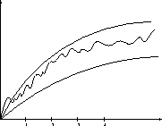
Doing the Analysis
It’s hard to estimate the running time exactly
  Best case depends on the input
  Average case is difficult to compute
  So we usually focus on worst case analysis
    Easier to compute
    Usually close to the actual running time
Strategy: find a function (an equation) that, for large n, is an upper bound to the actual function (actual number of steps, memory usage, etc.)
Upper bound
Actual function
Lower bound

Slide 35
Asymptotic notations
Upper bound O(g(N))
Lower bound Ω(g(N))
Tight bound Θ(g(N))

Slide 36

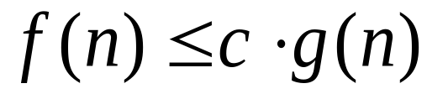
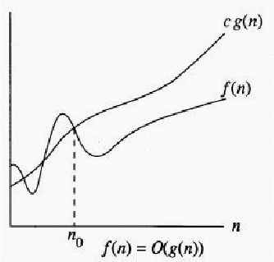
Big - O
Definition:
if there exist constants c>0 and n₀ such that for all n>n₀,

Slide 37

Big - O
if we can prove that
for constant c and n₀ where
  c≥0 and n₀≥1
Then we can say
C | n | f(n)=3n+2 | c.g(n)=c.n
4 | 1 | 5 | 4
4 | 2 | 8 | 8
4 | 3 | 11 | 12
4 | 5 | 17 | 20
Example: 1
Lets say f(n)=3n+2 and g(n)=n
We have to prove:
f(n) ≤ cg(n)
3n+2 ≤c.n

Slide 38
Big - O
Example: 1
Lets say f(n)=3n+2 and g(n)=n
We have to prove:
f(n) ≤ cg(n)
3n+2 ≤c.n
Example: 1
So we can say:
for c=4 and for all n≥2
f(n) ≤ cg(n)
C | n | f(n)=3n+2 | c.g(n)=c.n
4 | 1 | 5 | 4
4 | 2 | 8 | 8
4 | 3 | 11 | 12
4 | 5 | 17 | 20

Slide 39
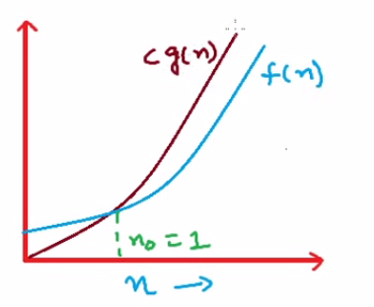
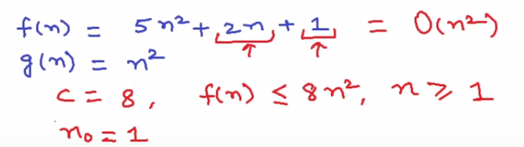

Slide 40
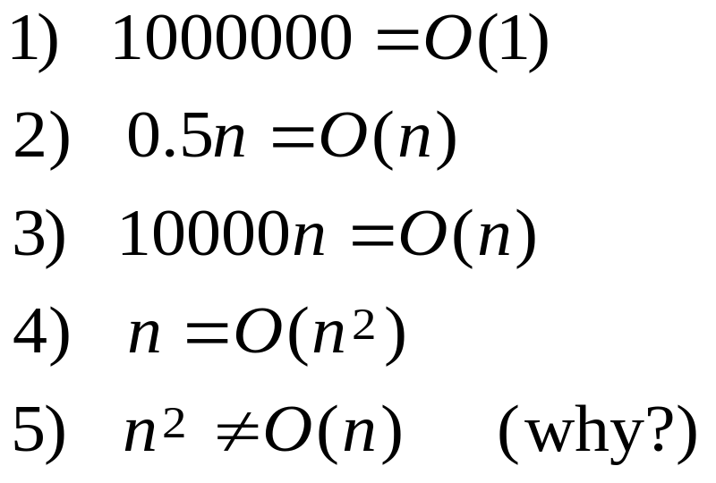
Big - O
In other words, g(n) bounds f(n) from above (for large n’s) up to a constant.
Examples:

Slide 41
Common time complexities
BETTER
WORSE
O(1) constant time
O(log n) log time
O(n) linear time
O(n log n) log linear time
O(n²) quadratic time
O(n³) cubic time
O(2^{n}) exponential time

Slide 42
Big-O Analysis in General
Examples of dominant terms:
n dominates log₂(n)
n*log₂(n) dominates n
n² dominates n*log₂(n)
n^{m} dominates n^{k} when m > k
a^{n} dominates n^{m} for any a > 1 and m >= 0
That is, log₂(n) < n < n*log₂(n) < n² < … < n^{m} < a^{n} for a >= 1 and m > 2
13-<number>

Slide 43
Big Oh: more examples
N² / 2 – 3N = O(N²)
1 + 4N = O(N)
7N² + 10N + 3 = O(N²)
log₁₀ N = log₂ N / log₂ 10 = O(log₂ N) = O(log N)
sin N = O(1); 10 = O(1), 10¹⁰ = O(1)
log N + N = O(N)

Slide 44

O(1) constant
Algorithms whose solutions are independent of the size of the problem’s inputs are said to have constant time complexity
Constant time complexity is denoted as O(1)

Slide 45
O(1) constant
retrieve, replace, and swap operations in array are O(1): array indexing allows direct access to an array location, independent of the array size; no shifting occurs
  All operations in stack are O(1), provided that the tail of the list is the top of the stack

Slide 46
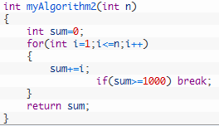
O(n)
Loops
  at most the running time of the statements inside the for-loop (including tests) times the number of iterations.
  O(N)

Slide 47

O(n²)
Nested loops
  the running time of the statement multiplied by the product of the sizes of all the for-loops.
  O(N²)

Slide 48
O(n²)
int x = 0;
for ( int j = 1; j <= n/2; j++ )
for ( int k = 1; k <= n*n; k++ )
x = x + j + k;
Outer loop executes n/2 times.
For each of those times, inner loop executes n² times,
so the body of the inner loop is executed (n/2)*n² = n³/2 times.
The algorithm is O(n³) .

Slide 49
O(n²)
int x = 0;
for ( int j = 1; j <= n; j++ )
for ( int k = 1; k < 3*j; k++ )
x = x + j;
When j is 1, inner loop executes 3 times;
when j is 2, inner loop executes 3*2 times; …
when j is n, inner loop executes 3*n times.
In all the inner loop executes 3+6+9+…+3n = 3(1+2+3+…+n)
= 3n²/2 + 3n/2 times.
The algorithm is O(n²).

Slide 50
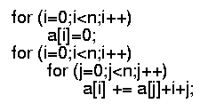
Consecutive statements
  These just add
  O(N) + O(N²) = O(N²)
Conditional: If S1 else S2
  never more than the running time of the test plus the larger of the running times of S1 and S2.
  O(1)

Slide 51
Analyzing Algorithms
Predict the amount of resources required:
  memory: how much space is needed?
  computational time: how fast the algorithm runs?
FACT: running time grows with the size of the input
Input size (number of elements in the input)
  Size of an array, polynomial degree, # of elements in a matrix, # of bits in the binary representation of the input, vertices and edges in a graph
Def: Running time = the number of primitive operations (steps) executed before termination
  Arithmetic operations (+, -, *), data movement, control, decision making (if, while), comparison

Slide 52
Algorithm Complexity
Worst Case Complexity:
  the function defined by the maximum number of steps taken on any instance of size n
Best Case Complexity:
  the function defined by the minimum number of steps taken on any instance of size n
Average Case Complexity:
  the function defined by the average number of steps taken on any instance of size n

Slide 53
Motivation for Asymptotic Analysis
An exact computation of worst-case running time can be difficult
  Function may have many terms:
    4n² - 3n log n + 17.5 n - 43 n^{⅔} + 75
An exact computation of worst-case running time is unnecessary
  Remember that we are already approximating running time by using RAM model

Slide 54
Classifying functions by their
Asymptotic Growth Rates (1/2)
asymptotic growth rate, asymptotic order, or
order of functions
  Comparing and classifying functions that ignores
    constant factors and
    small inputs.
The Sets big oh O(g), big theta Θ(g), big omega Ω(g)

Slide 55
Classifying functions by their
Asymptotic Growth Rates (2/2)
O(g(n)), Big-Oh of g of n, the Asymptotic Upper Bound;
Θ(g(n)), Theta of g of n, the Asymptotic Tight Bound; and
Ω(g(n)), Omega of g of n, the Asymptotic Lower Bound.

Slide 56
Visualization of O(g(n))
cg(n)
f(n)
n₀

Slide 57
Big - O
Example: 1
Lets say f(n)=3n+2 and g(n)=n
We have to prove:
f(n) ≤ cg(n)
3n+2 ≤c.n
Example: 1
So we can say:
for c=4 and for all n≥2
f(n) ≤ cg(n)
C | n | f(n)=3n+2 | c.g(n)=c.n
4 | 1 | 5 | 4
4 | 2 | 8 | 8
4 | 3 | 11 | 12
4 | 5 | 17 | 20

Slide 58
Examples
  2n² = O(n³):
  n² = O(n²):
  1000n²+1000n = O(n²):
  n = O(n²):
2n² ≤ cn³ ⇒ 2 ≤ cn ⇒ c = 1 and n₀= 2
n² ≤ cn² ⇒ c ≥ 1 ⇒ c = 1 and n₀= 1
1000n²+1000n ≤ cn² ≤ cn²+ 1000n ⇒ c=1001 and n₀ = 1
n ≤ cn² ⇒ cn ≥ 1 ⇒ c = 1 and n₀= 1

Slide 59
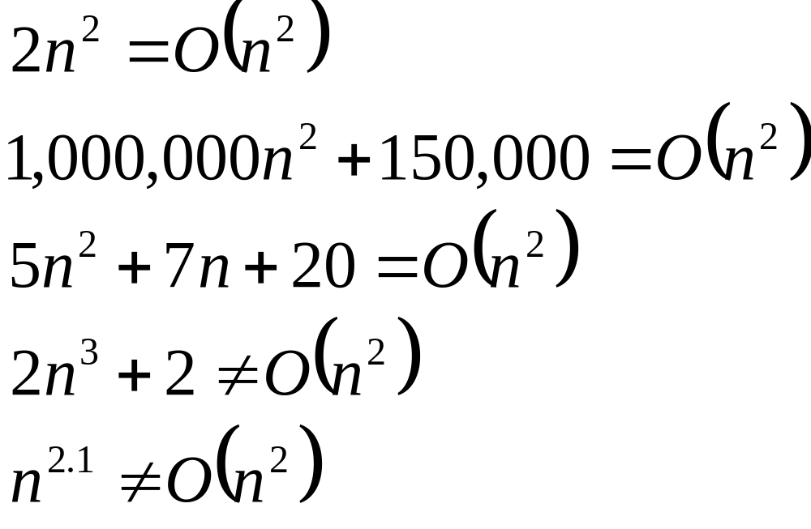
Big-O

Slide 60
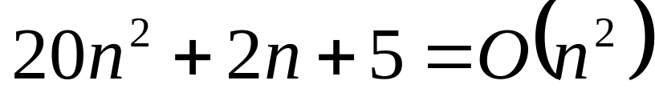
More Big-O
Prove that:
Let c = 21 and n₀ = 4
21n² > 20n² + 2n + 5 for all n > 4
n² > 2n + 5 for all n > 4
TRUE

Slide 61
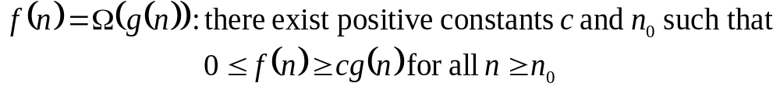
Big Omega – Notation
Ω() – A lower bound
  n² = Ω(n)
  Let c = 1, n₀ = 2
  For all n ≥ 2, n² > 1 × n

Slide 62
Visualization of Ω(g(n))
f(n)
cg(n)
n₀

Slide 63
Visualization of Ω(g(n))
Example: 1
Lets say f(n)=3n+2 and g(n)=n
We have to prove:
f(n) ≥ cg(n)
3n+2 ≥c.n
f(n)
cg(n)
Example: 1
So we can say:
for c=1 and for all n≥1
f(n) ≥ cg(n)
n₀
C | n | f(n)=3n+2 | c.g(n)=c.n
1 | 1 | 5 | 1
1 | 2 | 8 | 2
1 | 3 | 11 | 3
1 | 4 | 14 | 4

Slide 64
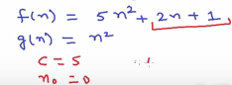
Visualization of Ω(g(n))
f(n)
cg(n)
n₀

Slide 65
Visualization of Ω(g(n))
Example: 2
Lets say f(n)=3n+2 and g(n)=n²
We have to prove:
f(n) ≥ cg(n)
3n+2 ≥c.n
f(n)
cg(n)
n₀
We can not find such a constant c so that for all n ≥1 can satisfy our condition.

Slide 66
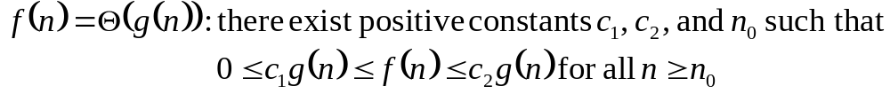
Θ-notation
Θ provides a tight bound

Slide 67
Visualization of Θ(g(n))
c₂g(n)
f(n)
c₁g(n)
n₀

Slide 68
Visualization of Θ(g(n))
Example: Firstly
Lets say f(n)=3n+2 and g(n)=n
We have to prove:
f(n) ≤ c₂ g(n)
3n+2 ≤ c₂.n
c₂ | n | f(n)=3n+2 | c₂.g(n)=c₂.n
4 | 1 | 5 | 4
4 | 2 | 8 | 8
4 | 3 | 11 | 12
4 | 5 | 17 | 20
Example: Secondly
Lets say f(n)=3n+2 and g(n)=n²
We have to prove:
f(n) ≥ cg(n)
3n+2 ≥c.n
c₁ | n | f(n)=3n+2 | c₁.g(n)=c₁.n
1 | 1 | 5 | 1
1 | 2 | 8 | 2
1 | 3 | 11 | 3
1 | 4 | 14 | 4

Slide 69
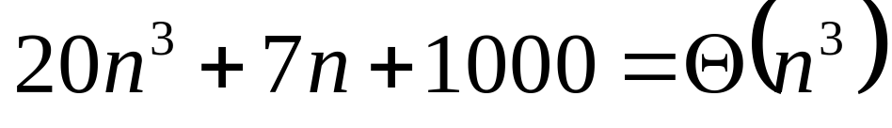
Example 2
Prove that:
Let c = 21 and n₀ = 10
21n³ > 20n³ + 7n + 1000 for all n > 10
n³ > 7n + 5 for all n > 10
TRUE, but we also need…
Let c = 20 and n₀ = 1
20n³ < 20n³ + 7n + 1000 for all n ≥ 1
TRUE

Slide 70
O(1) constant
Algorithms whose solutions are independent of the size of the problem’s inputs are said to have constant time complexity
Constant time complexity is denoted as O(1)

Slide 71
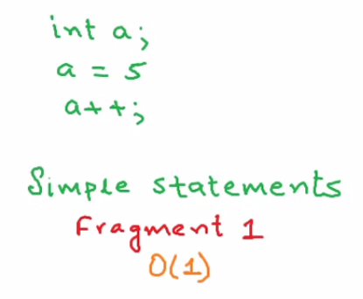
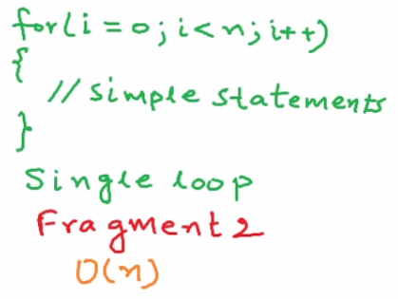
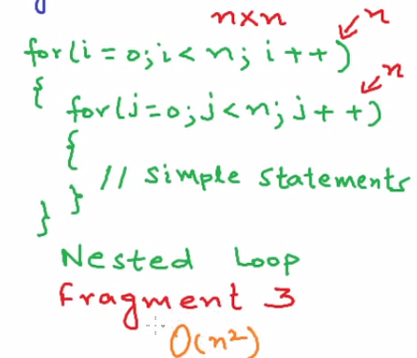
Some common rules

Slide 72
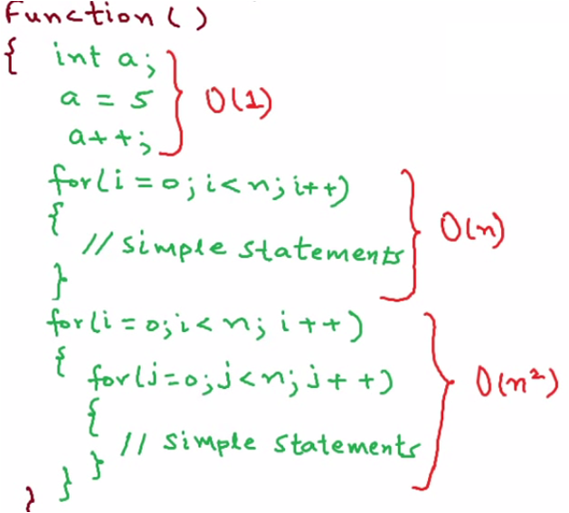
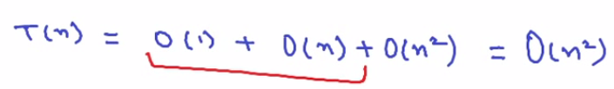

Slide 73
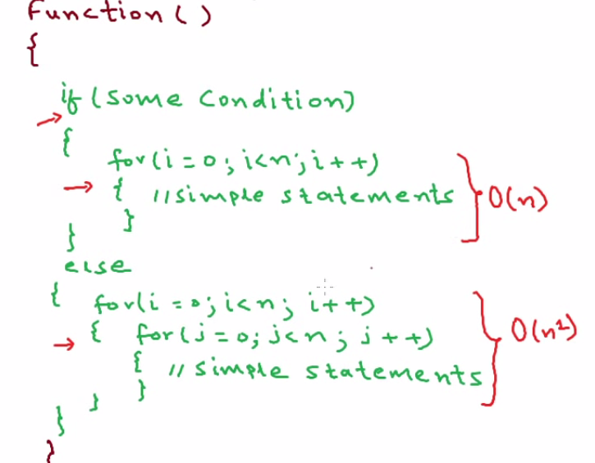
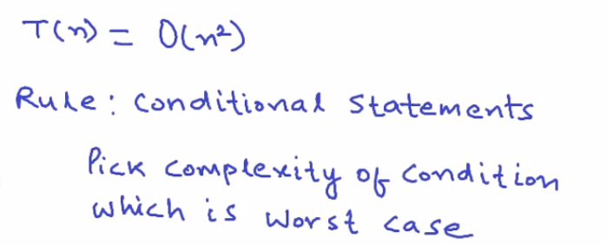

Slide 74
Example
Code:
a = b;
Complexity:
Notes:
constant

Slide 75
Example
Code:
sum = 0;
for (i=1; i <=n; i++)
sum += n;
Complexity:
Notes:
linear

Slide 76
Example
Code:
sum = 0;
for (j=1; j<=n; j++)
for (i=1; i<=j; i++)
sum++;
for (k=0; k<n; k++)
A[k] = k;
Complexity:
Notes:
N squared == 1 + 2 + … + N

Slide 77
Example
Code:
sum1 = 0;
for (i=1; i<=n; i++)
for (j=1; j<=n; j++)
sum1++;
Complexity:
Notes:
Obviousy n squared

Slide 78
Example
Code:
sum2 = 0;
for (i=1; i<=n; i++)
for (j=1; j<=i; j++)
sum2++;
Complexity:

Slide 79
Example
Code:
sum1 = 0;
for (k=1; k<=n; k*=2)
for (j=1; j<=n; j++)
sum1++;
Complexity:
Notes:
outer loop O(lg N), inner loop (N) == O (N lg N) by product rule

Slide 80
Example
Code:
sum2 = 0;
for (k=1; k<=n; k*=2)
for (j=1; j<=k; j++)
sum2++;
Complexity:
Notes:
outer O (lg N) inner = sum of powers of 2 which is linear since
The sum of powers of 2 dividing into N is 2N so its O (N lg N) by product rule

Slide 81

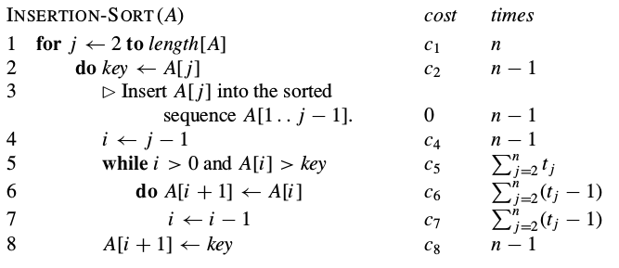
Analysis of Insertion sort

Slide 82
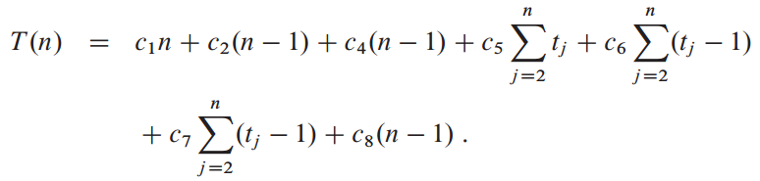
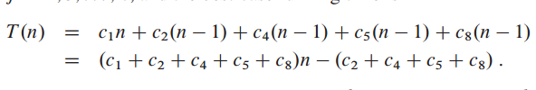
Analysis of Insertion sort

Slide 83
References
Introduction to algorithm by Cormen, chapter 3 (Growth of functions)

